Slide 1

TECHNICAL PRESENTATION OF THE PROJECT ON
WEBSITE OF THE RING RESTAURANT

Slide 2

Agenda
Introduction to the project
Introduction to Web Development
Software Model Adopted
Technology
HTML
Introduction to CSS
JavaScript
Introduction to PHP
Development Tools
PhpMyAdmin
Features
E-R Diagram
Data Flow Diagram
Snapshot of developed application
Reference

Slide 3

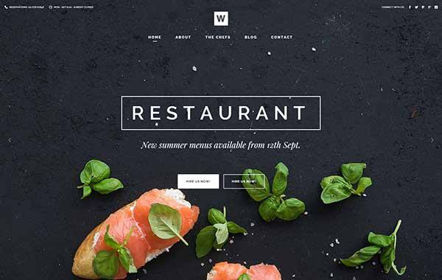
Introduction to the project
A website is a collection of web pages and related content that is identified by a common domain name and published on at least one web server. Our project is based on a website of a restaurant. It defines all the important information about the Ring Restaurant. Whenever we look for a good restaurant then a website is a way to find out the best one. Starting from location in google map, menu, price of the items, history of restaurant, the photos of the place are there in the website. Apart from that one can reserve table from the website and also can give feedback message to the restaurant. So, this website is a very easy way to reach to the restaurant for users.

Slide 4

Web Development
Introduction to Web Development
Web development is the work involved in developing a Web site for the Internet or an intranet. Web development can range from developing a simple single static page of plain text to complex web applications, electronic businesses, and social network services
First, we have to design our web pages using html, css. Then we add JavaScript in our project to make the web pages interactive. After that back-end development is needed using PhP, my Sql to store the data in the database.

Slide 5
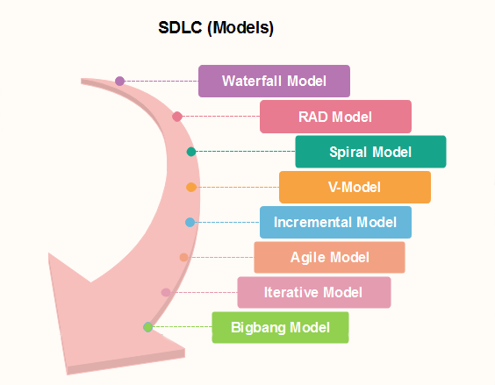
Software Model Adopted
Every model is used in different cases based on its features. Here in our project we basically adopted the Iterative Software Process Model.
An iterative life cycle model does not attempt to start with a full specification of
requirements by first focusing on an initial, simplified set user features, which
then progressively gains more complexity and a broader set of features until the targeted system is complete. In other words, the iterative approach begins by specifying and implementing just part of the software, which can then be
reviewed and prioritized in order to identify further requirements. This iterative
process is then repeated by delivering a new version of the software for each
iteration.
We had started our development with some requirement and that was not the
final set of the requirement of this project. After implementing these requirement
we add some another requirement to that set and continue our development
process. In this way we implement a requirement set , tested it and add some
more requirement and again developed and tested. In every phase or in every
iteration the website was updated and a new version was launched. So, we can say, Iterative Software Process model is adopted by us to develop this project.

Slide 6
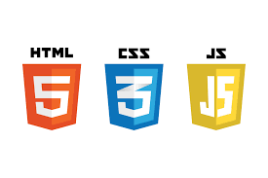
Technology Used
HTML
CSS
JAVASCRIPT
PHP

Slide 7
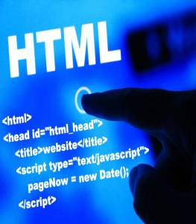
Html
The HyperText Markup Language, or HTML is the standard markup language for documents designed to be displayed in a web browser.
HTML stands for Hyper Text Markup Language
HTML is the standard markup language for creating Web pages
HTML describes the structure of a Web page
HTML consists of a series of elements
HTML elements tell the browser how to display the content
HTML elements label pieces of content such as "this is a heading", "this is a paragraph", "this is a link", etc
“

Slide 8
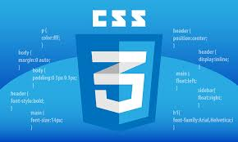
Introduction to CSS
CSS is the language we use to style a Web page.
CSS stands for Cascading Style Sheets
CSS describes how HTML elements are to be displayed on screen, paper, or in other media
CSS saves a lot of work. It can control the layout of multiple web pages all at once
External stylesheets are stored in CSS files
Cascading Style Sheets

Slide 9

JavaScript
JavaScript is a text-based programming language used both on the client-side and server-side that allows you to make web pages interactive. Where HTML and CSS are languages that give structure and style to web pages, JavaScript gives web pages interactive elements that engage a user
JavaScript is the world's most popular programming language.
JavaScript is the programming language of the Web.
JavaScript is easy to learn.

Slide 10
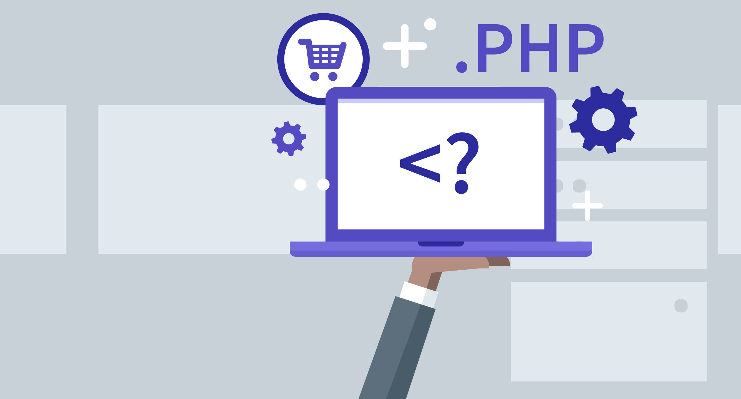
Introduction to PHP
PHP is a general-purpose scripting language especially suited to web development. It was originally created by Danish-Canadian programmer Rasmus Lerdorf in 1994. The PHP reference implementation is now produced by The PHP Group.
PHP is an acronym for "PHP: Hypertext Preprocessor"
PHP is a widely-used, open source scripting language
PHP scripts are executed on the server
PHP is free to download and use

Slide 11
Development Tools
Sublime Text
Xampp

Slide 12
Sublime Text is a shareware cross-platform source code editor with a Python application programming interface. It natively supports many programming languages and markup languages, and functions can be added by users with plugins, typically community-built and maintained under free-software licenses
Sublime Text:
XAMPP is a free and open-source cross-platform web server solution stack package developed by Apache Friends, consisting mainly of the Apache HTTP Server, MariaDB database, and interpreters for scripts written in the PHP and Perl programming languages
Xampp:

Slide 13
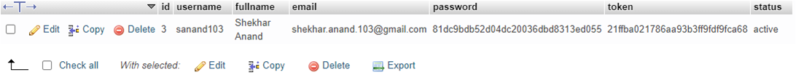
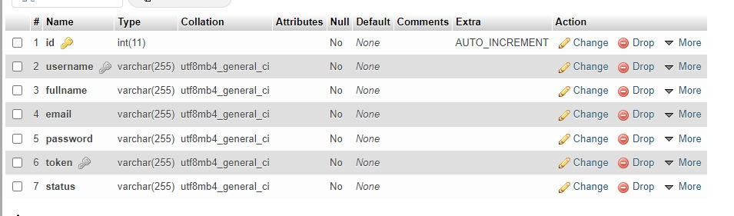

PhpMyAdmin
Row of the database table
phpMyAdmin is a free and open source administration tool for MySQL and MariaDB. As a portable web application written primarily in PHP, it has become one of the most popular MySQL administration tools, especially for web hosting services. We can use phpMyAdmin to perform most administration tasks, including creating a database, running queries, and adding user accounts.
Database Table

Slide 14

Features
Firstly, user have to Create a ne account with his or her email address.
At the time registration user must provide his name.
After that user can login with his email id and given password.
After successfully log in , user can see the home page of the restaurant. Here user can see the location of the restaurants and can go to the feedback page, table reservation page, menu page and about us page. In every page, a digital clock will running there and there is the logout option present in every pages.
In about us page users can view about the details of the restaurant.
In menu-categories page user can see all the dishes available in the restaurant with a short explanation and price. So that, user can understand about the cost and dished.
When user want to reserve a table in the restaurant then he or she can do that from the website. For that he or she have to fill up a form which basically contains the name, email, date and time i.e. when user want to book the table and the number of person. After clicking Book Now button there will be a confirmation box appeared and if user cancel it then the booking will be canceled. On the other hand, if user click yes ten the table will be reserved successfully and after that there will be a option to take print of the filled up form. It can be act as a document to the user.
In our website there is another feature to send feedback about the restaurant. So, that the restaurant can improve their services.

Slide 15
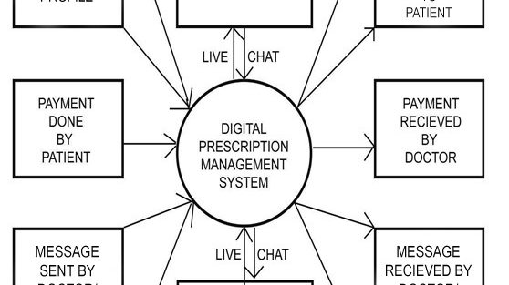
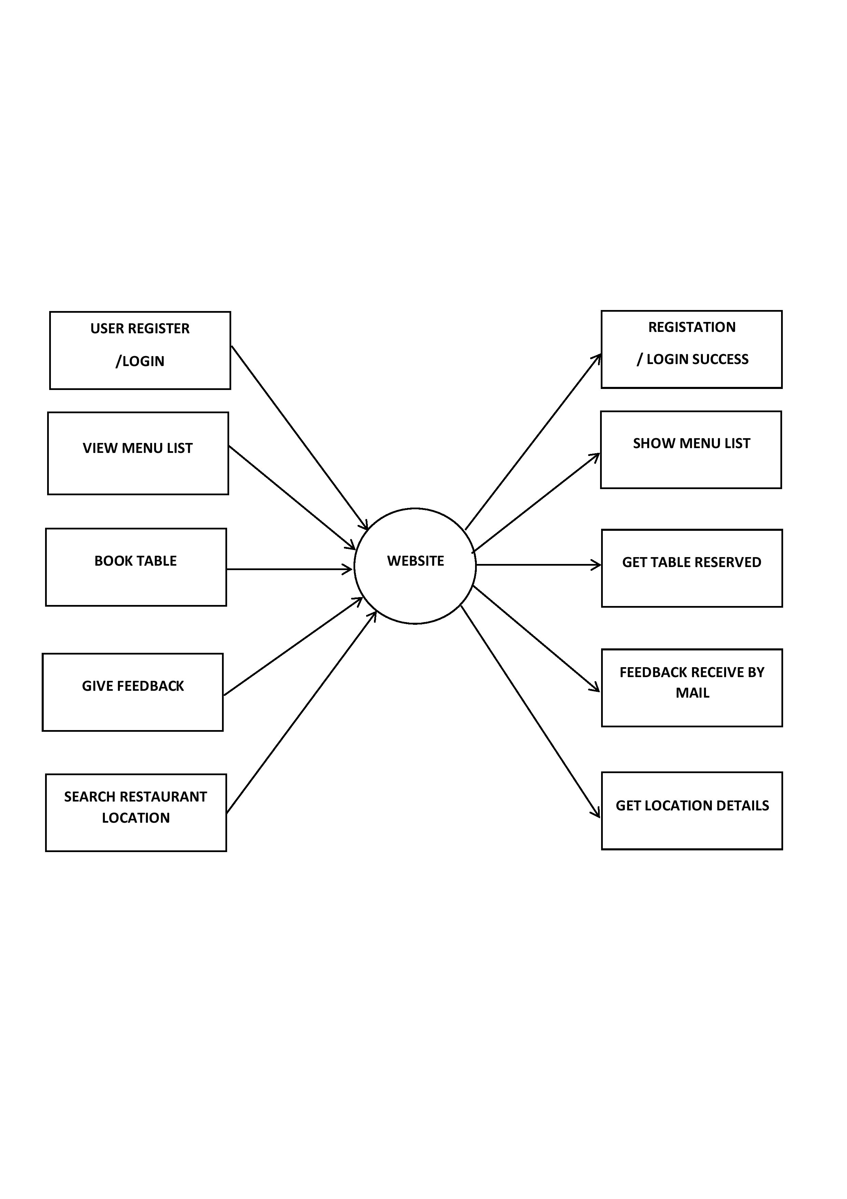
Data Flow Diagram
Context Level DFD OF THE SYSTEM

Slide 16
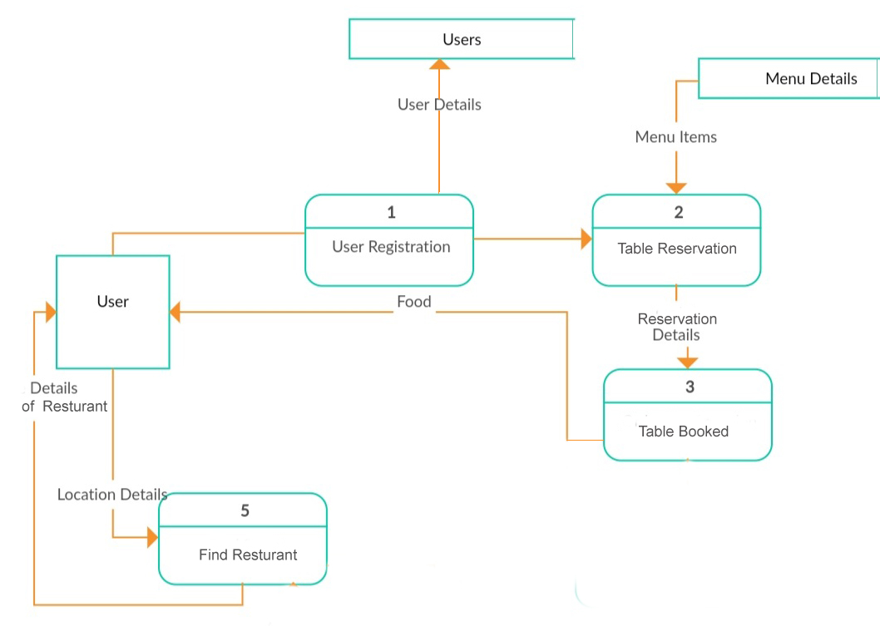
Data Flow Diagram
Level 1 DFD OF THE SYSTEM

Slide 17
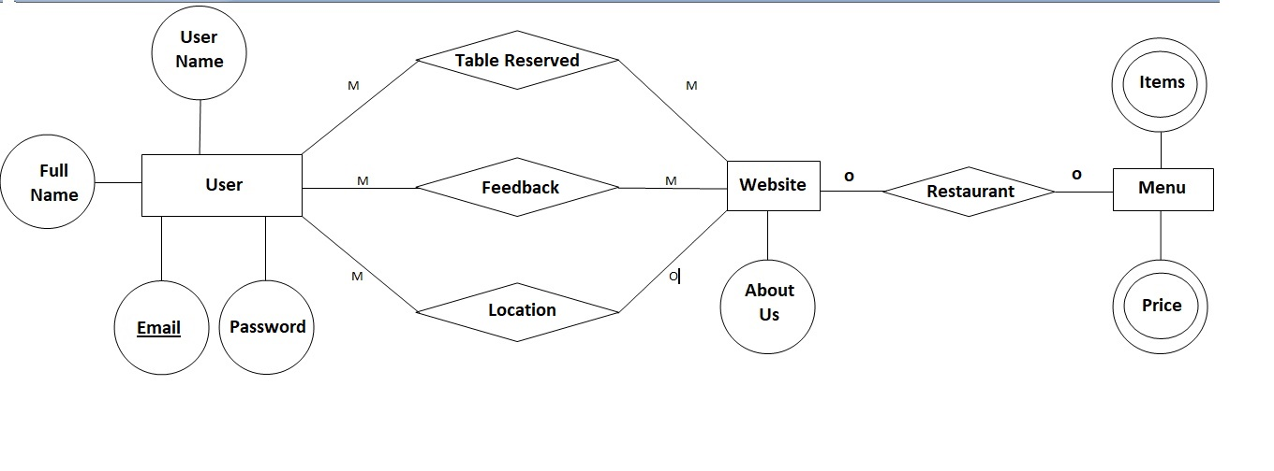
Entity Relationship Diagram
ER DIAGRAM OF THE SYSTEM

Slide 18
Snapshots
The snapshots will give us a clear view of our developed webstie…

Slide 19
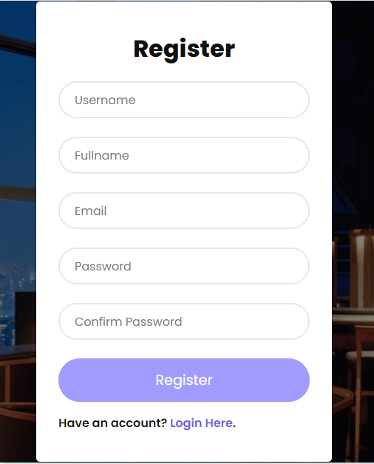
Registration View
Registration Page…
When Patient want to create new account…

Slide 20
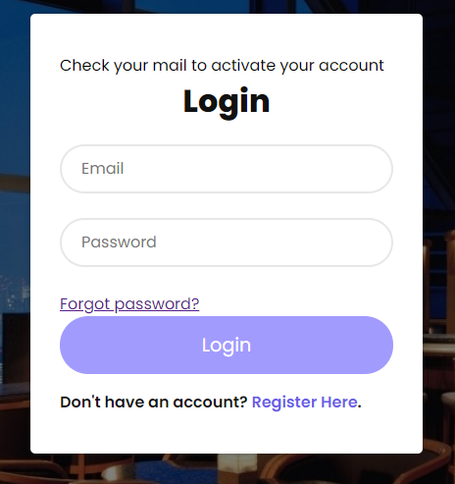
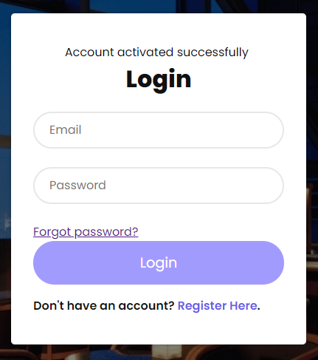
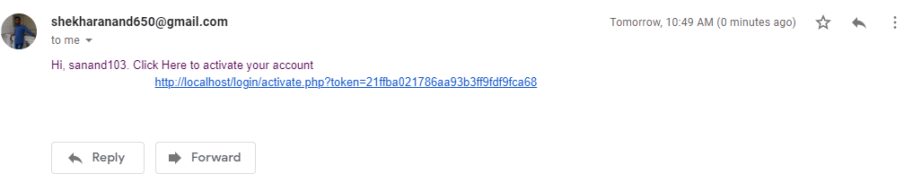
Email Verification
After registration email verification Is needed…
Get the message to check your email
Successfully Activation
Message in mail

Slide 21
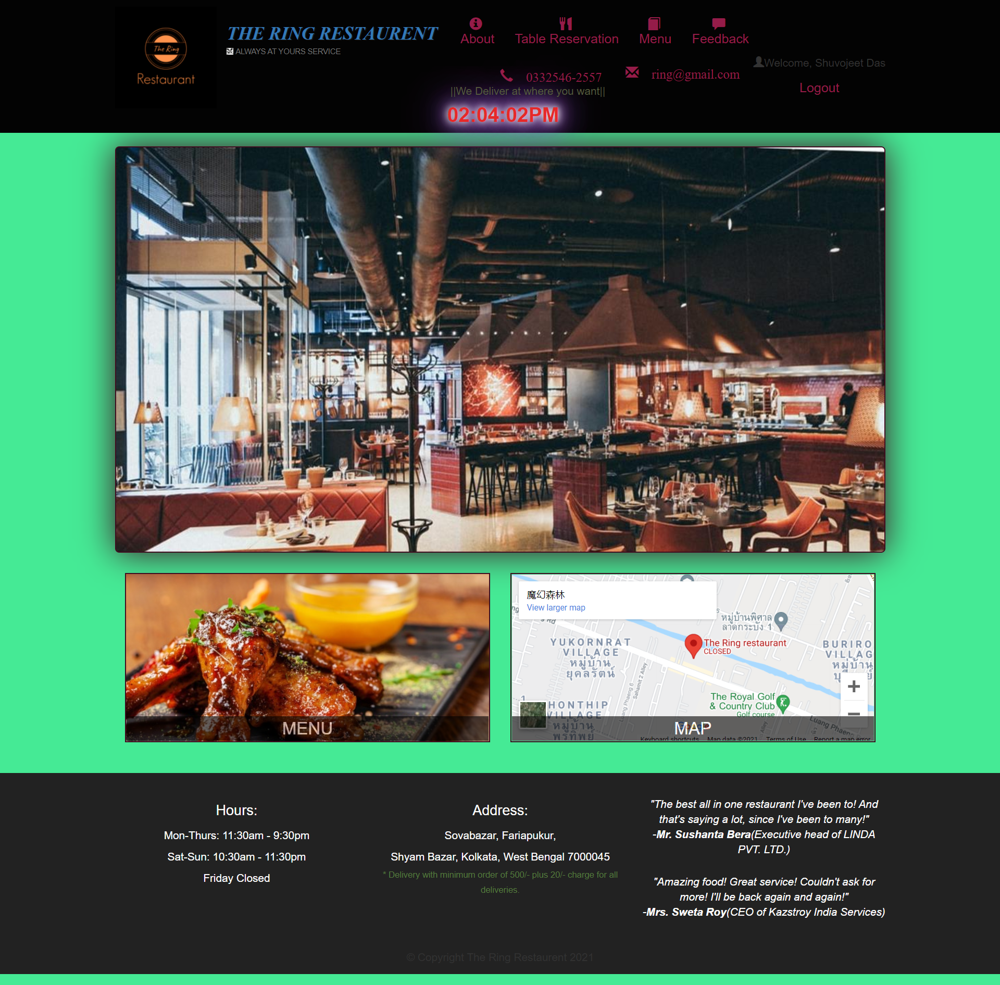
Home Page View
After successful log in home page will appear..

Slide 22
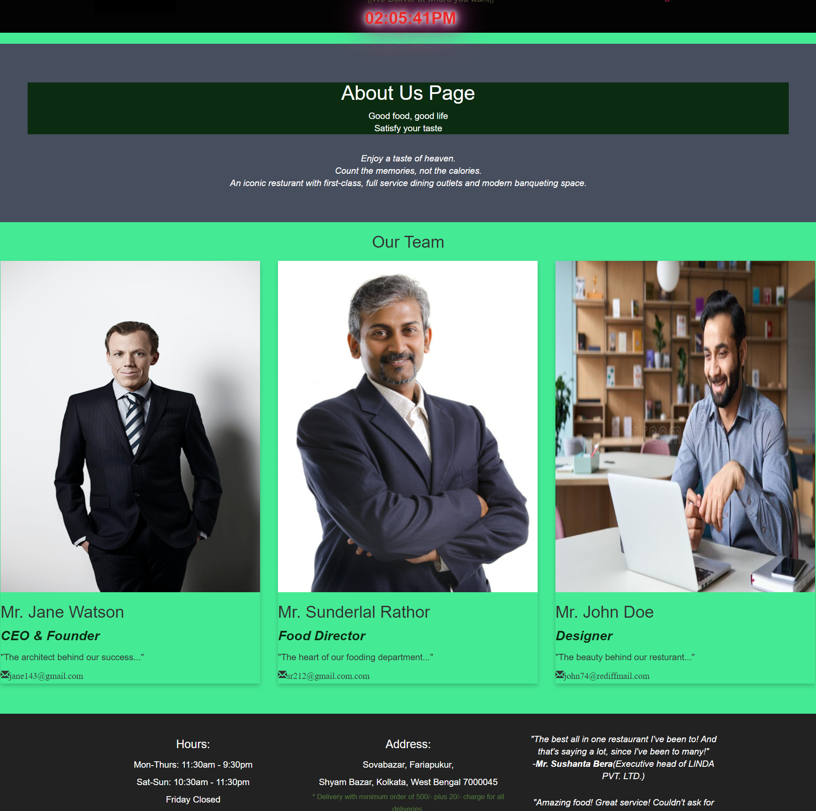
About Us page

Slide 23
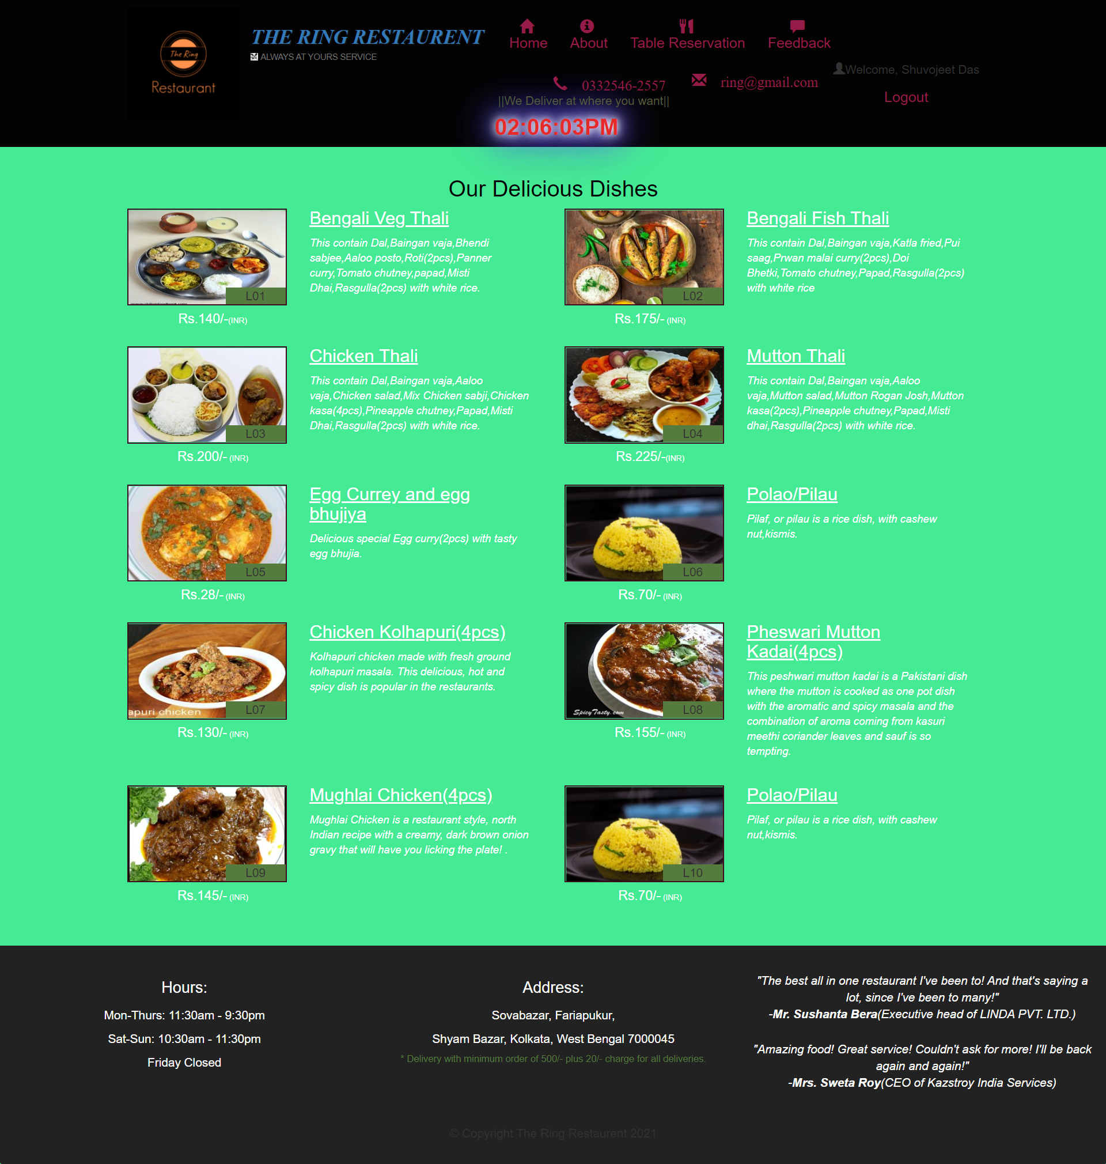
Menu-Categories Page
From here customer can see all dishes with its price…

Slide 24
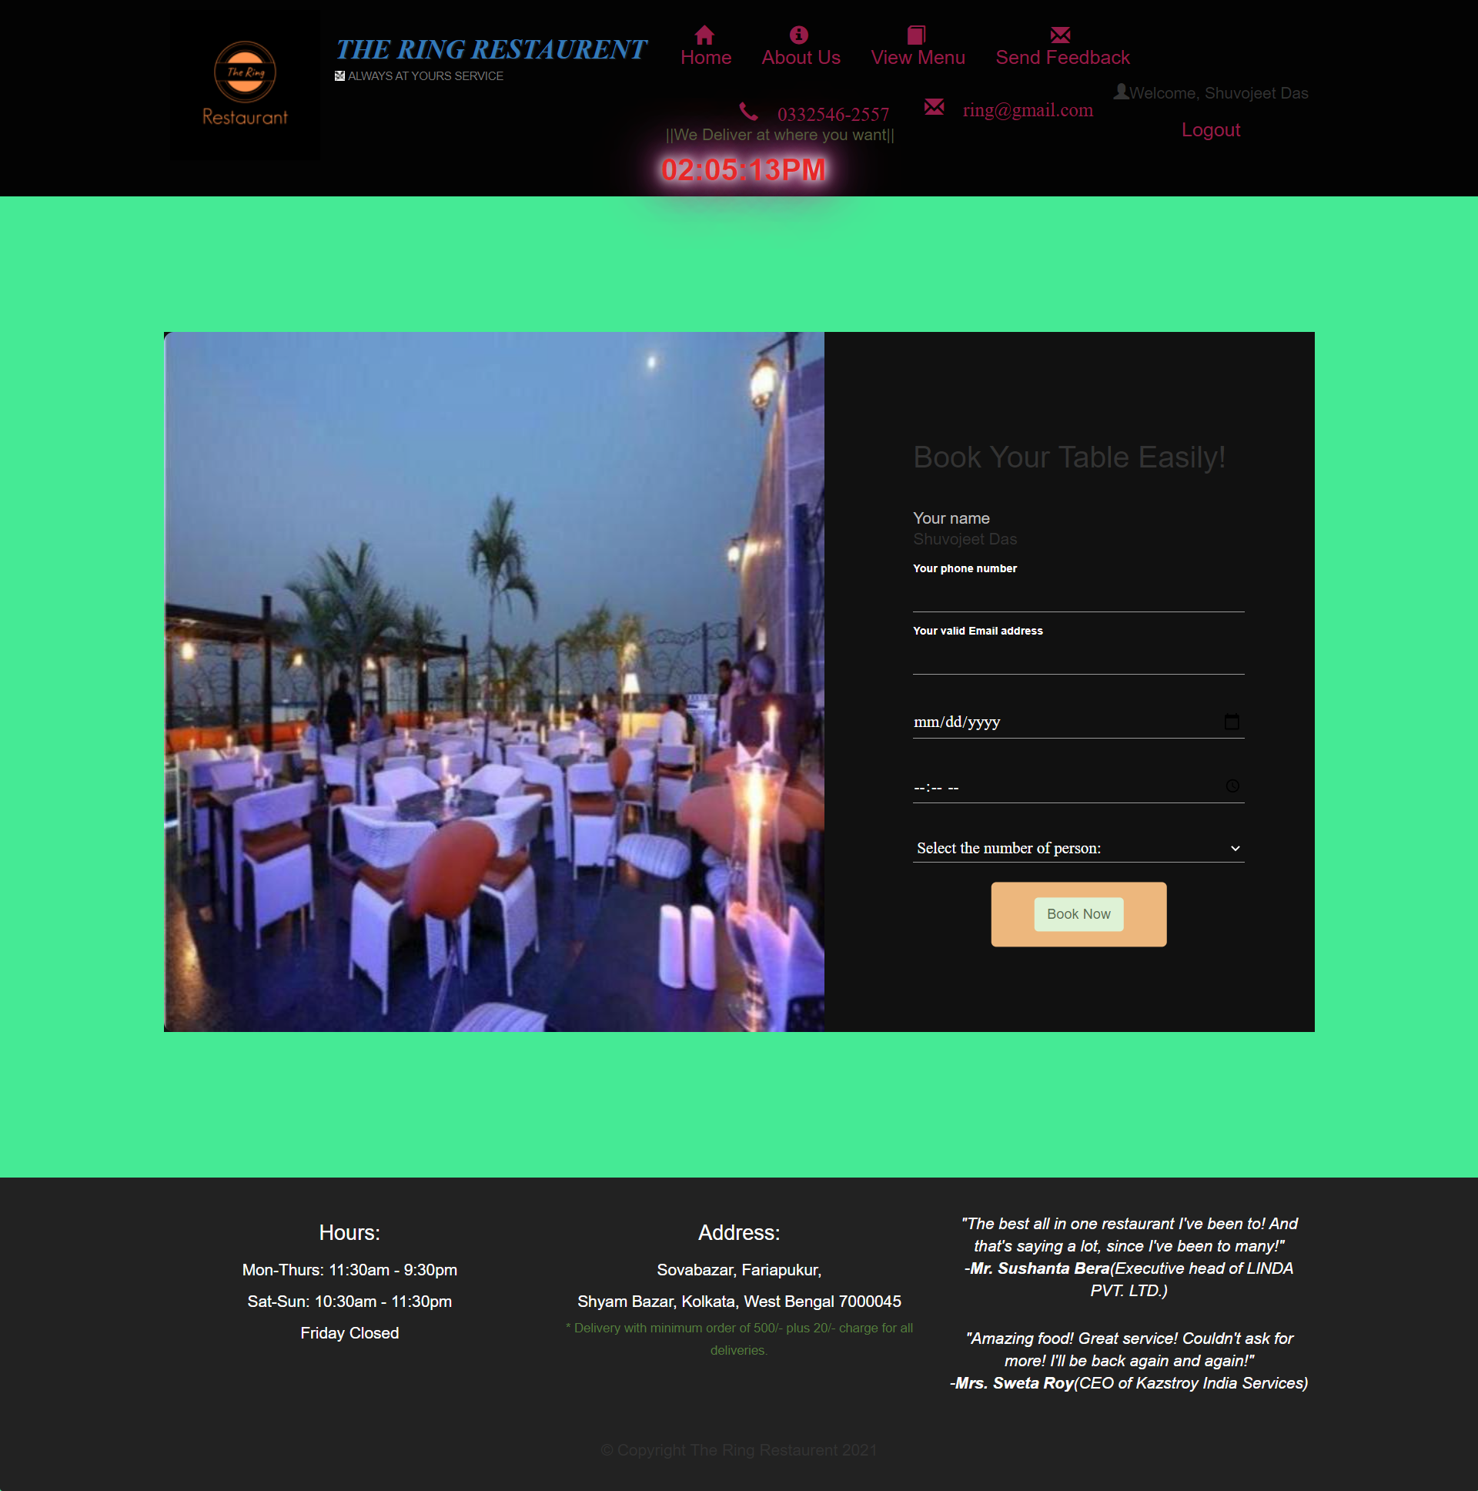
Table-Reservation page
Customer can reserve a table online from this website…

Slide 25
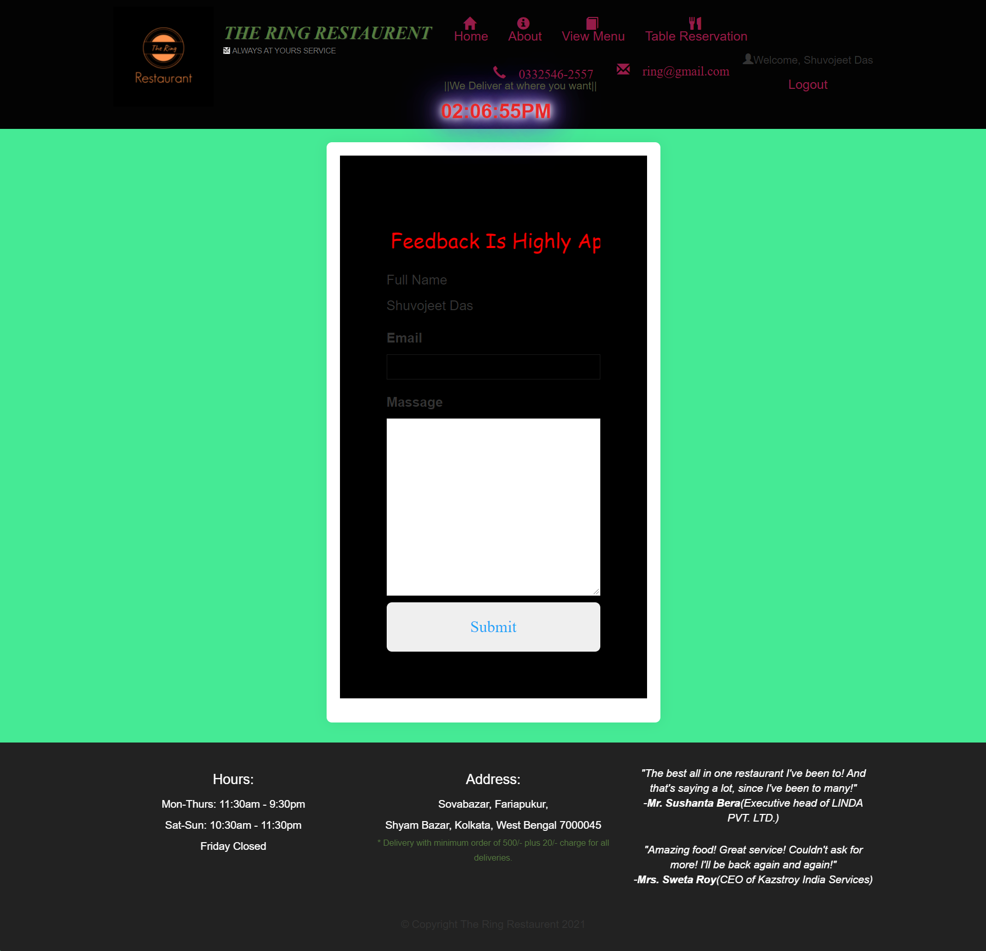
Feedback Page
Customer can give the restaurant a feedback message, so that restaurant can improve…

Slide 26

Reference
https://www.w3schools.com/html/html_css.asp
https://www.w3schools.com/css/
https://www.codecademy.com/catalog/language/javascript
www.google.com
https://www.phpmyadmin.net/
https://www.apachefriends.org/index.html

Slide 27

THANK YOU
Thank You

